Slide 1
Summary Sheet Figures and Maps
Updated December 2018
The mark “CDC” is owned by the US Dept. of Health and Human Services and is used with permission. Use of this logo is not an endorsement by HHS or CDC of any particular product, service, or enterprise.
This project is supported by the U.S. President’s Emergency Plan for AIDS Relief (PEPFAR) through CDC under the terms of cooperative agreements #U2GGH001271 and #U2GGH001226. The findings and conclusions in this report are those of the authors and do not necessarily represent the official position of the funding agencies
Notes:
Ministry of Health and Central Statistical Office, Kingdom of Eswatini, U.S. Centers for Disease Control and Prevention (CDC), and ICAP at Columbia University.
Swaziland HIV Incidence Measurement Survey 2 (SHIMS2) 2018: Summary Sheet. Mbabane, Eswatini; Atlanta, USA; New York, USA. December 2018.

Slide 2
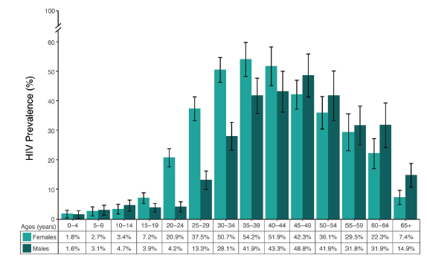
HIV Prevalence by Age and Sex, SHIMS2 2016-2017
Error bars represent 95% confidence intervals.
Notes:
HIV prevalence peaks at 54.2% among females ages 35 to 39 years and 48.8% among males ages 45 to 49 years.
The disparity in HIV prevalence by sex is most pronounced among young adults: HIV prevalence among 20- to 24-year-olds is five times higher among females (20.9%) than males (4.2%).

Slide 3
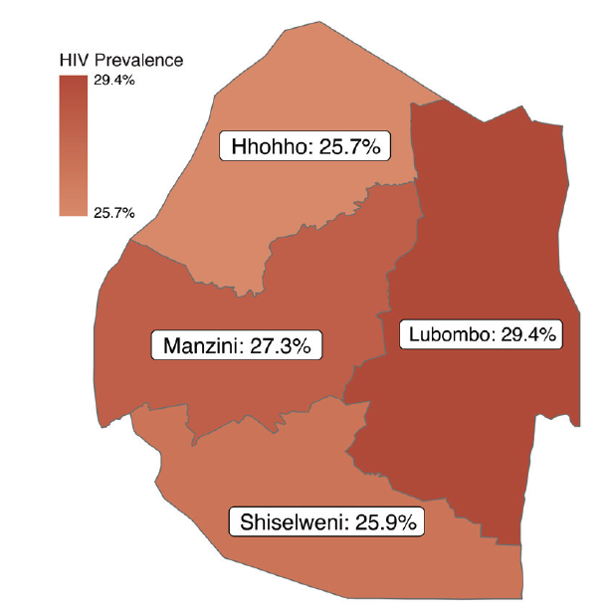
HIV Prevalence among Adults, by Region, SHIMS2 2016-2017
Notes:
Among adults ages 15 and older, prevalence of HIV has no significant geographic variation across Eswatini, ranging from 25.7% in Hhohho to 29.4% in Lubombo.

Slide 4
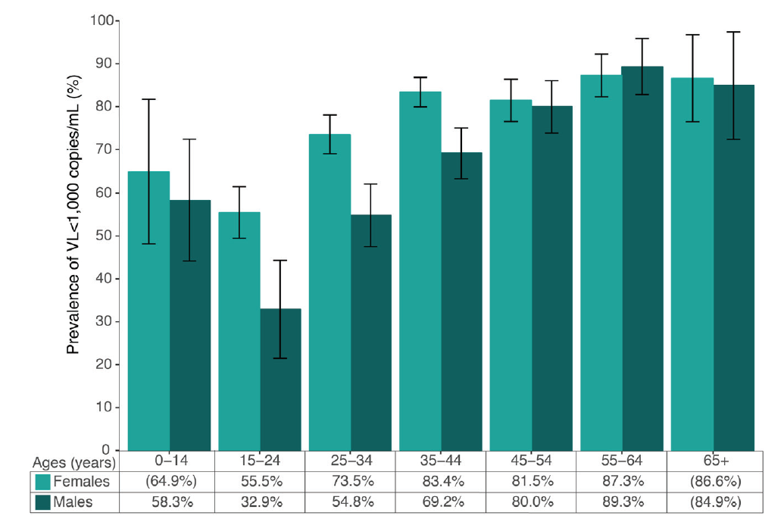
Prevalence of Viral Load <1,000 copies/mL among all Participants living with HIV, Regardless of Knowledge of HIV Status or Reported ART Use, by Age and Sex, SHIMS2 2016-2017
Error bars represent 95% confidence intervals.
Estimates in parenthesis are based on a small number (25-49) of unweighted cases and should be interpreted with caution.
Notes:
Prevalence of viral load <1,000 copies/ml among HIV-positive people, regardless of knowledge of HIV status or ART use, in Eswatini is highest among older adults:
87.3% among HIV-positive females and 89.3% among HIV-positive males ages 55 to 64 years.
In contrast, prevalence of VLS is lowest among younger adults:
55.5% among HIV-positive females and 32.9% among HIV-positive males ages 15 to 24 years.

Slide 5
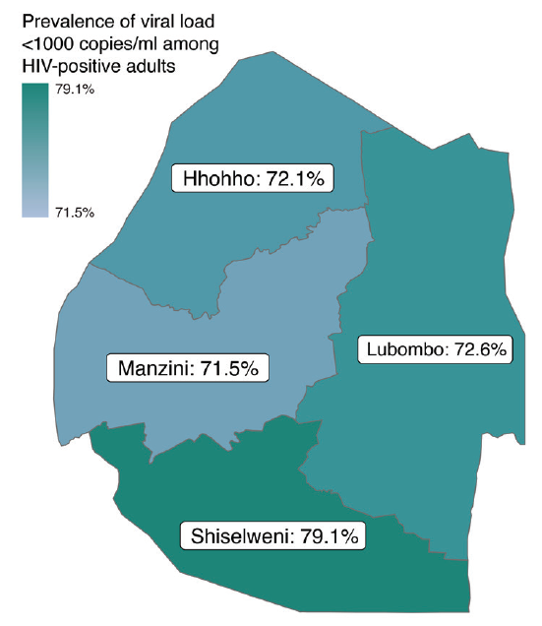
Prevalence of Viral Load <1,000 copies/mL among Adults living with HIV, Regardless of Knowledge of HIV Status or Reported ART Use, by Region, SHIMS2 2016-2017
Notes:
Among HIV-positive adults ages 15 and older, prevalence of viral load <1,000 copies/ml among HIV-positive people (regardless of knowledge of HIV status or ART use) has minimal geographic variation across Eswatini, ranging from 71.5% in Manzini to 79.1% in Shiselweni.

Slide 6
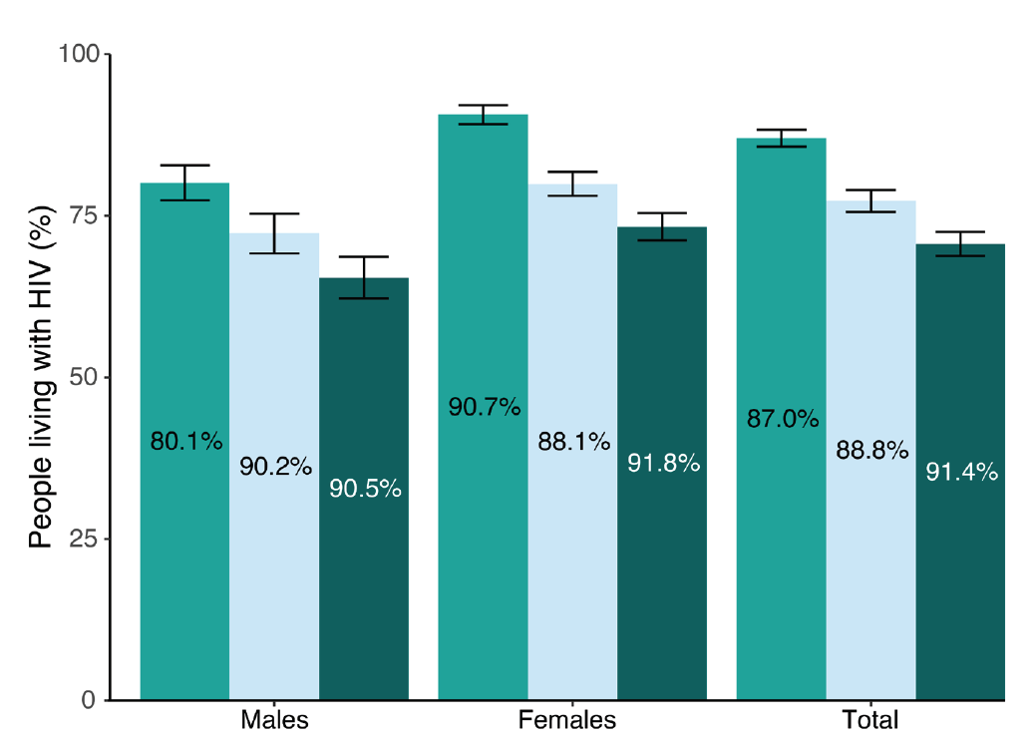
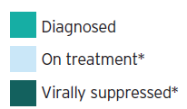
Achievement of the 90-90-90 Goals among HIV-Positive Adults, by Sex, SHIMS2 2016-2017
Error bars represent 95% confidence intervals.
Inset numbers are conditional proportions.
Notes:
Diagnosed: In Eswatini, 87.0% of PLHIV ages 15 and older know their HIV status: 80.1% of HIV-positive males and 90.7% of HIV-positive females. Knowing their HIV status was defined as self-reporting HIV-positive and/or having a detectable antiretroviral (ARV) in the blood.
On Treatment: Among PLHIV ages 15 and older who know their HIV status, 88.8% are on ART: 90.2% of HIV-positive males and 88.1% of HIV-positive females. Being on ART was defined as self-reporting current use of ART and/or
having a detectable ARV in the blood.
Virally Suppressed: Among PLHIV ages 15 and older on ART, 91.4% are virally suppressed: 90.5% of HIV-positive males and 91.8% of HIV-positive females.

Slide 7
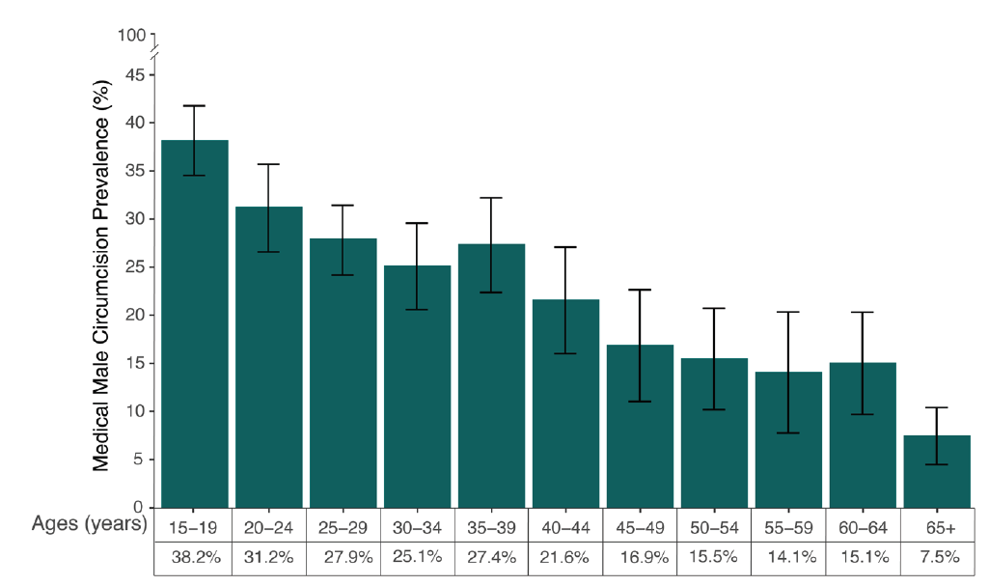
Medical Circumcision among Adult Males, by Age, SHIMS2 2016-2017
Error bars represents 95% confidence intervals
Notes:
Among males 15 years and older, prevalence of medical circumcision is 26.7%.
Prevalence of medical circumcision decreases with age, from 38.2% among 15- to 19-year olds to 7.5% among males 65 and older.
One out of three 15- to 24-year old males is circumcised (34.8%), compared with one out of five males ages 25 years and older (21.9%).

Slide 8
Find the SHIMS2 Summary Sheet and additional PHIA Project Results at: https://phia.icap.columbia.edu
The mark “CDC” is owned by the US Dept. of Health and Human Services and is used with permission. Use of this logo is not an endorsement by HHS or CDC of any particular product, service, or enterprise.
This project is supported by the U.S. President’s Emergency Plan for AIDS Relief (PEPFAR) through CDC under the terms of cooperative agreements #U2GGH001271 and #U2GGH001226. The findings and conclusions in this report are those of the authors and do not necessarily represent the official position of the funding agencies
Notes:
Ministry of Health and Central Statistical Office, Kingdom of Eswatini, U.S. Centers for Disease Control and Prevention (CDC), and ICAP at Columbia University.
Swaziland HIV Incidence Measurement Survey 2 (SHIMS2) 2018: Summary Sheet. Mbabane, Eswatini; Atlanta, USA; New York, USA. December 2018.

