Slide 1
Summary Sheet Figures and Maps
Updated July 2018
The mark “CDC” is owned by the US Dept. of Health and Human Services and is used with permission. Use of this logo is not an endorsement by HHS or CDC of any particular product, service, or enterprise.
This project is supported by the U.S. President’s Emergency Plan for AIDS Relief (PEPFAR) through CDC under the terms of cooperative agreement #U2GGH001226. The findings and conclusions in this report are those of the authors and do not necessarily represent the official position of the funding agencies
Notes:
Ministry of Health, Cameroon, Centers for Disease Control and Prevention (CDC), and ICAP at Columbia University.
Cameroon Population-based HIV Impact Assessment (CAMPHIA) 2015-16: Summary Sheet. Yaoundé, Cameroon, Atlanta, Georgia and New York, New York, USA: Ministry of Health, CDC and ICAP. July 2018.

Slide 2
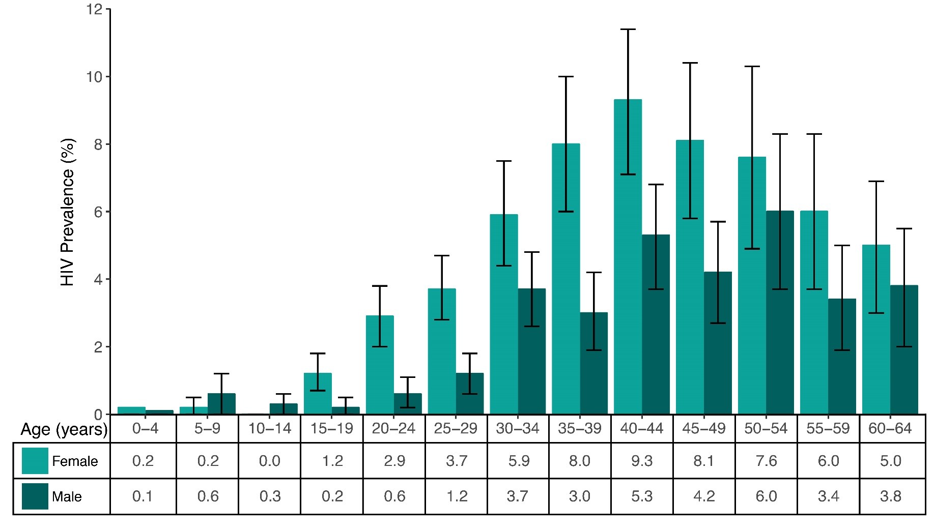
HIV Prevalence by Age and Sex, CAMPHIA 2017
Error bars represent 95% confidence intervals.
Notes:
HIV prevalence peaks at 9.3% among females ages 40-44, as compared to a peak of 6.0% among males ages 50-54.
Prevalence among 15-24 year olds is 1.2%: 2.0% among females and 0.4% among males.
The disparity in HIV prevalence between males and females is most pronounced among younger adults, with women in age groups 15-19, 20-24 and 25-29 all having prevalence at least triple that of males in the same age groups.

Slide 3
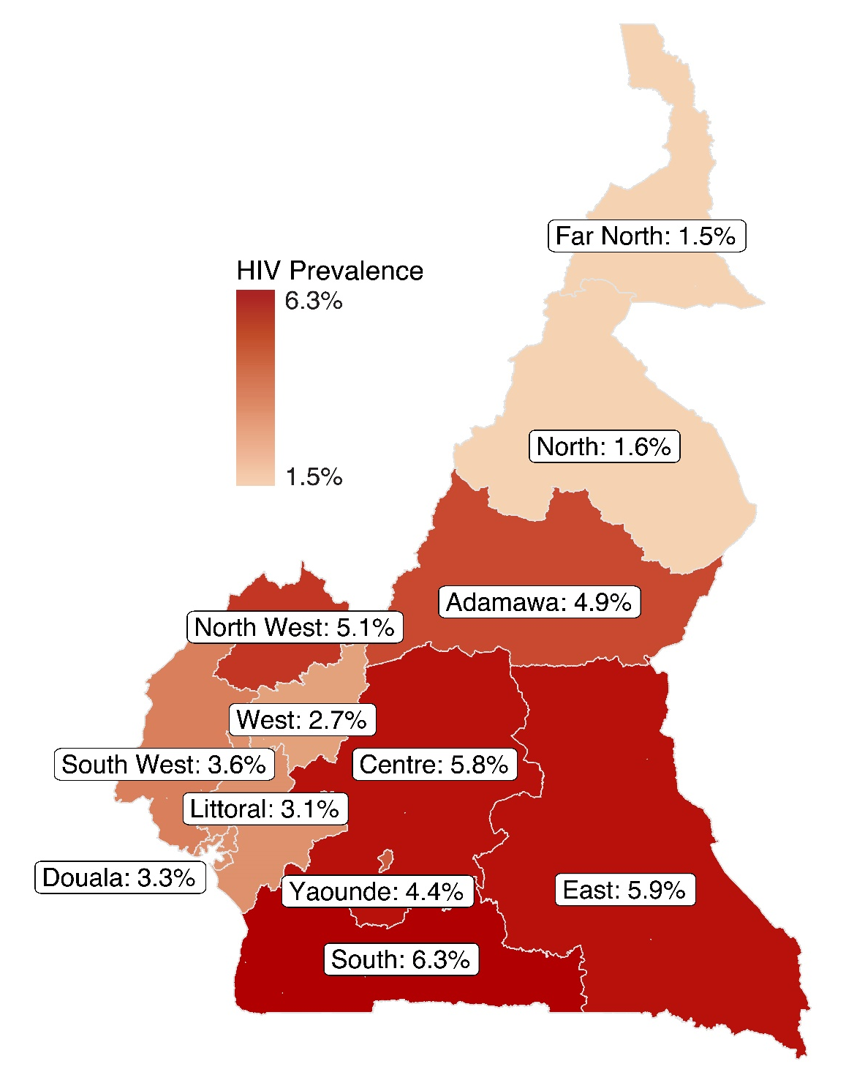
HIV Prevalence among Adults,
by Region, CAMPHIA 2017
Notes:
Among adults ages 15-64 years, HIV prevalence among adults varies by region, ranging from 6.3 percent in the South Region to 1.5 percent in the Far North Region.

Slide 4
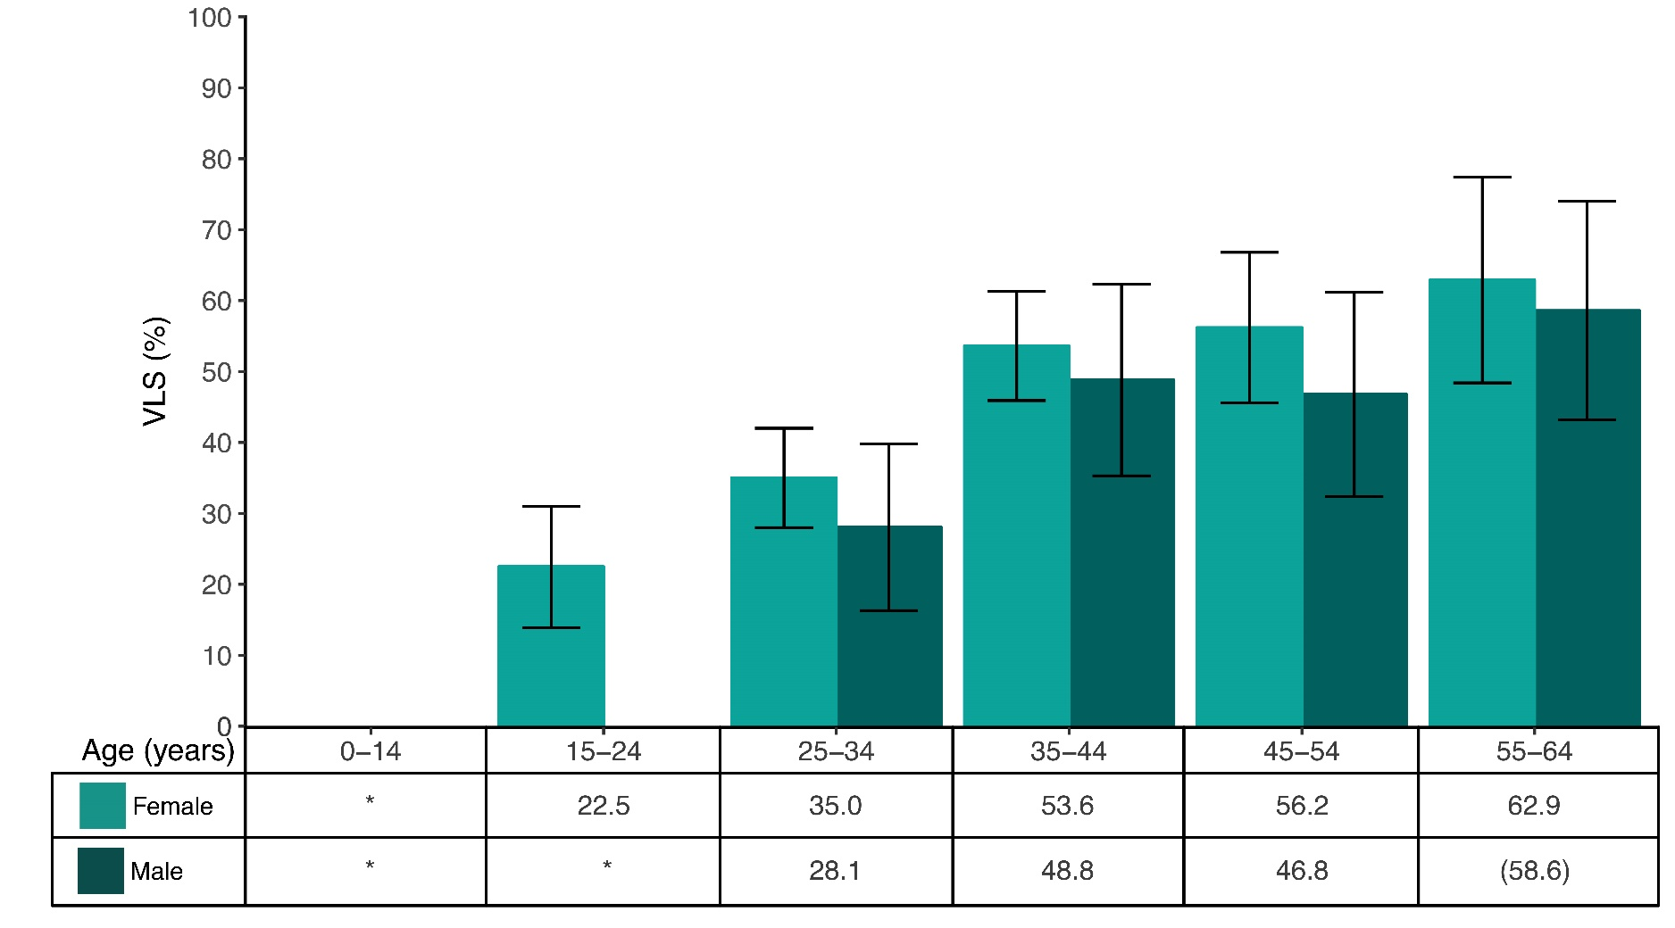
Viral Load Suppression among HIV-Positive People, by Age and Sex, CAMPHIA 2017
Error Bars represent 95% confidence intervals.
*Estimates for males and females ages 0-14, and males ages 15-24 are based on a very small number (less than 25) of unweighted cases and have been suppressed.
Estimates in parentheses are based on a small number of unweighted cases (25-49) and should be interpreted with caution
Notes:
Viral load suppression among HIV positive individuals in Cameroon is highest among older adults, with 63% of females ages 55-64 virally suppressed, and 59% of males ages 55-64 virally suppressed.
There is little gender disparity in viral load suppression among adults, with 56% of females ages 45-54 virally suppressed and 47% of men in the same age group virally suppressed.

Slide 5
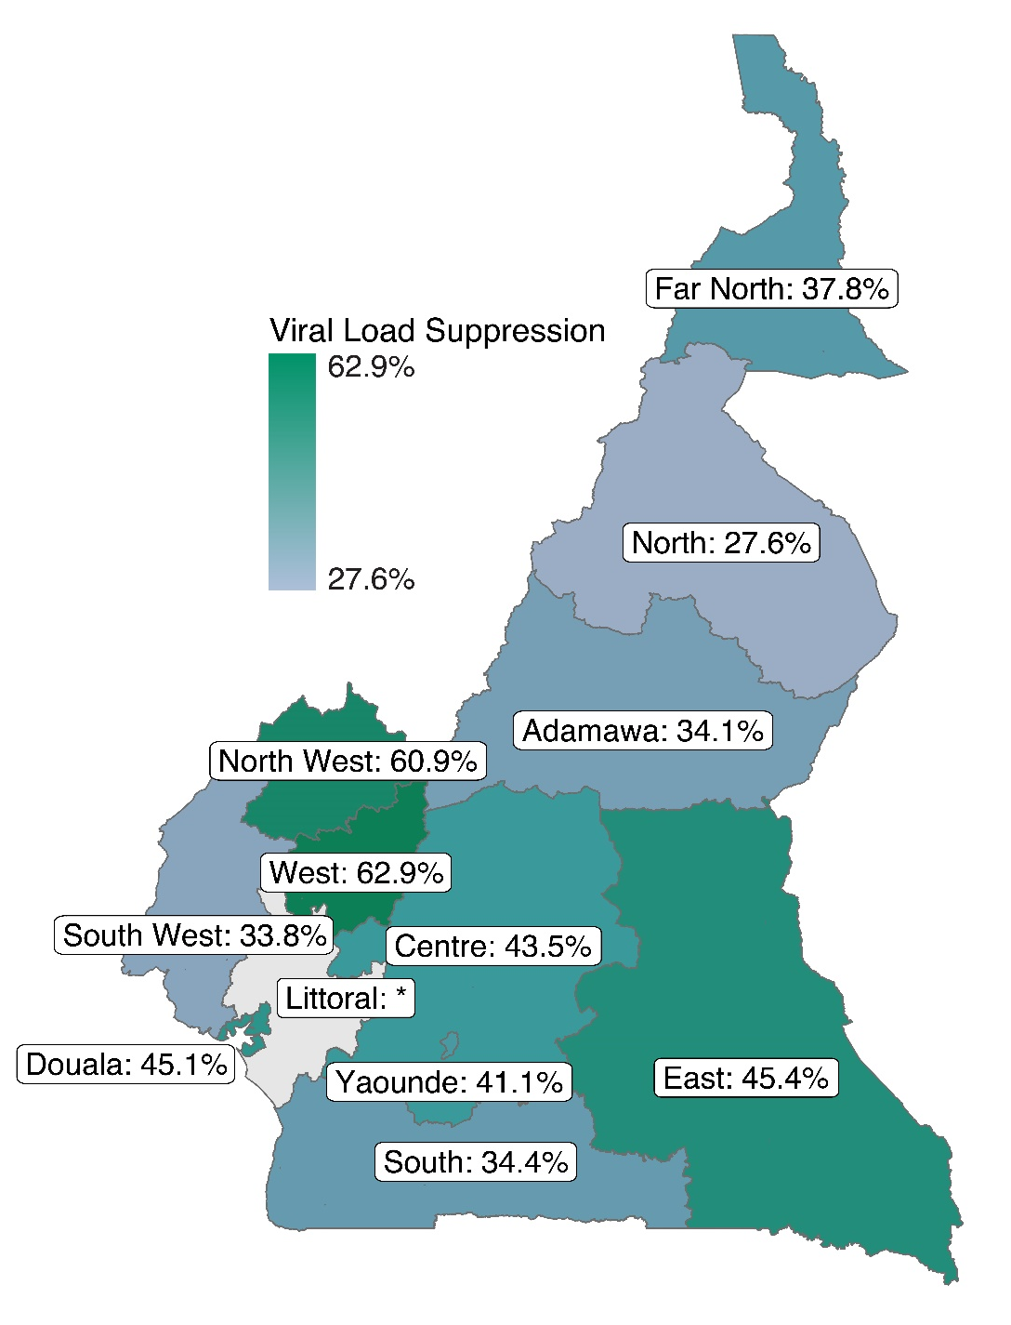
Viral Load Suppression among
HIV-Positive Adults, by Region,
CAMPHIA 2017
Estimate for Littoral region is based on a very small number (less than 25) of unweighted cases and has been suppressed.
Notes:
Among HIV positive adults ages 15-64 years, VLS varies by region, ranging from a high of 63% in the West Region to a low of 28% in the North Region.

Slide 6
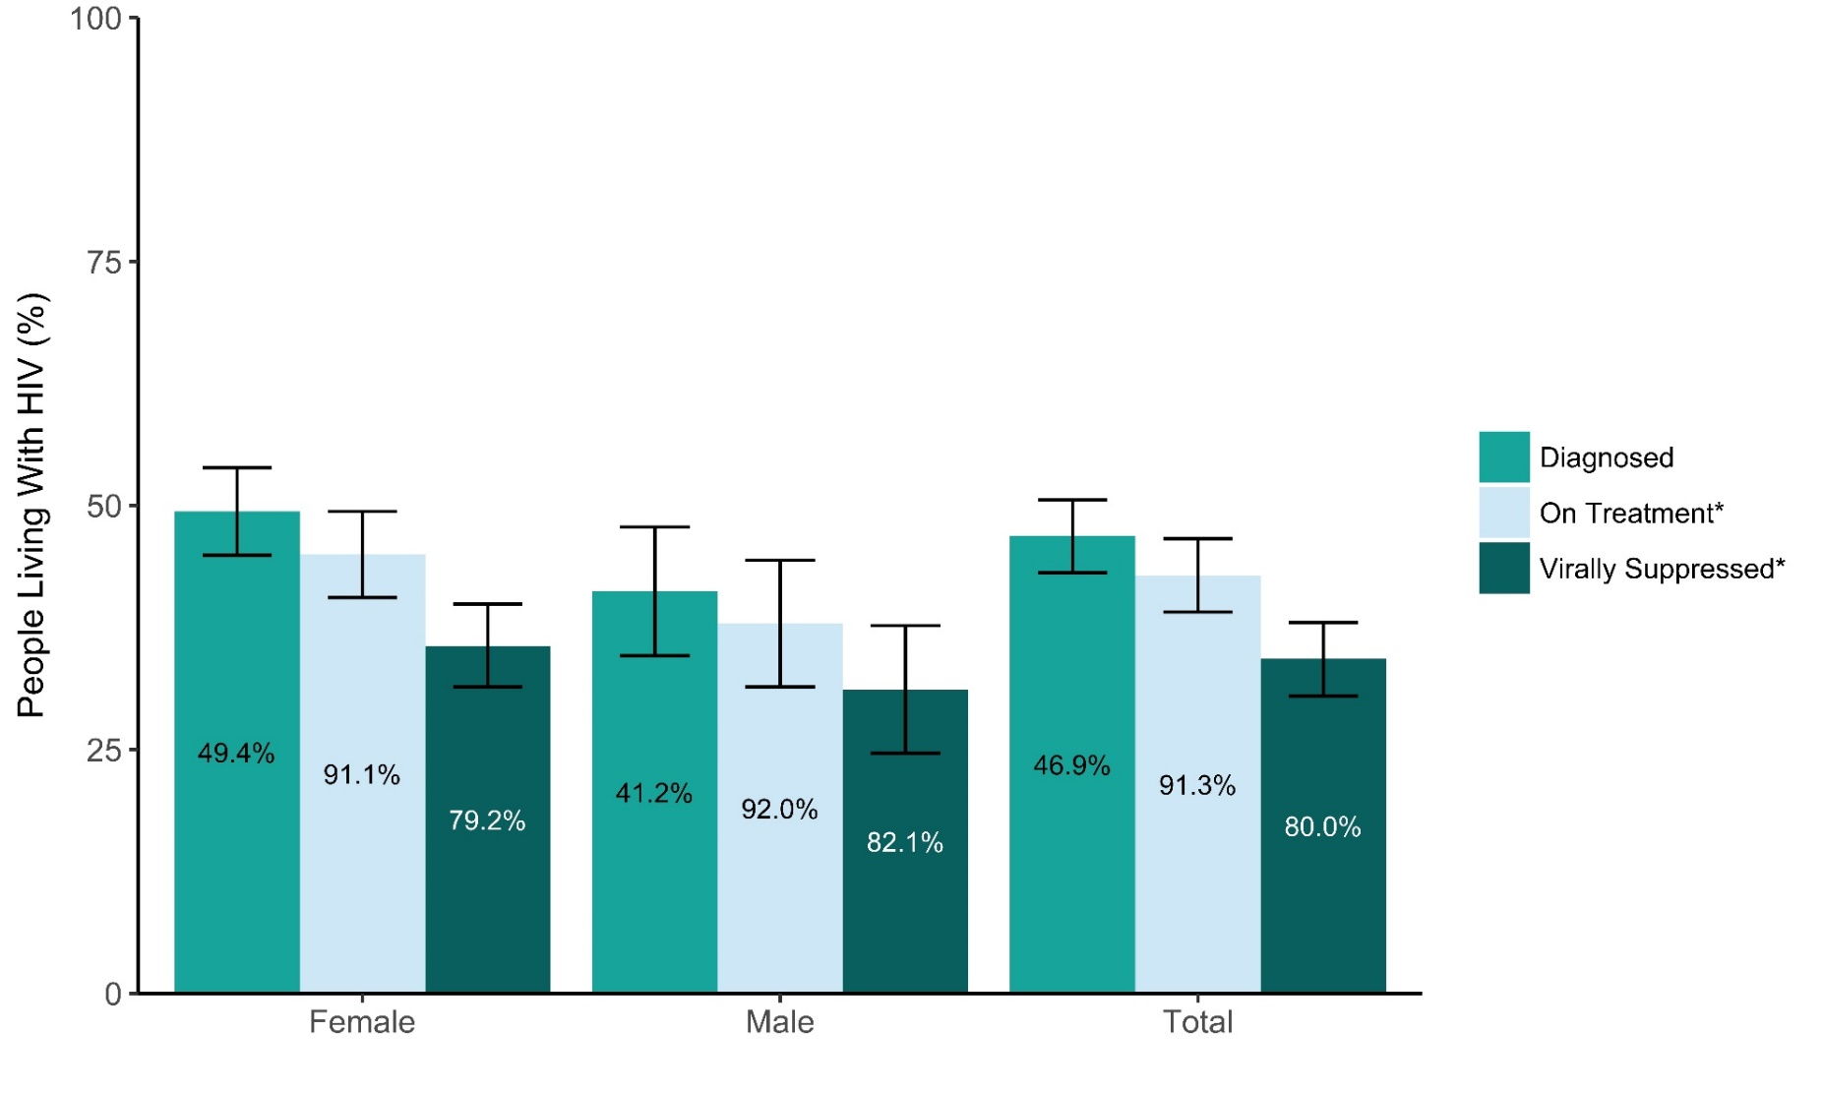
Achievement of the 90-90-90 Goals among HIV-Positive Adults, by Sex, CAMPHIA 2017
Error bars represent 95% confidence intervals.
*Inset numbers are conditional proportions.
For example, 46.9% of people who tested positive for HIV in the survey reported they already knew their positive status. Of those who knew their positive status, 91.3% were in treatment. Of those in treatment, 80% were virally suppressed.
Notes:
90–90–90: An ambitious treatment target to help end the AIDS epidemic By 2020, 90% of all PLHIV will know their HIV status; 90% of all people with diagnosed HIV infection will receive sustained antiretroviral therapy (ART); and 90% of all people receiving ART will have viral suppression.
Diagnosed: Note: Awareness was defined as self-reporting HIV positive and/or having a detectable antiretroviral (ARV) in the blood. In Cameroon, 46.9% of PLHIV ages 15-64 years report knowing their HIV status: 49.4% of HIV-positive females and 41.2% of HIV-positive males know their HIV status.
On Treatment: Note: Being on ART was defined as self-reporting current use of ART and/or having a detectable ARV in the blood. Among PLHIV ages 15-64 years who know their HIV status, 91.3% self-report current use of ART: 91.1% of HIV-positive females and 92.0% of HIV-positive males who know their HIV status self-report current use of ART.
Virally Suppressed: Among PLHIV ages 15-64 years who self-report current use of ART, 80.0% are virally suppressed: 79.2% of HIV-positive females and 82.1% of HIV positive males who self-report current use of ART are virally suppressed.

Slide 7
Find the EPHIA Summary Sheet and additional PHIA Project Results at:
https://phia.icap.columbia.edu
The mark “CDC” is owned by the US Dept. of Health and Human Services and is used with permission. Use of this logo is not an endorsement by HHS or CDC of any particular product, service, or enterprise.
This project is supported by the U.S. President’s Emergency Plan for AIDS Relief (PEPFAR) through CDC under the terms of cooperative agreement #U2GGH001226. The findings and conclusions in this report are those of the authors and do not necessarily represent the official position of the funding agencies
Notes:
Ministry of Health, Cameroon, Centers for Disease Control and Prevention (CDC), and ICAP at Columbia University.
Cameroon Population-based HIV Impact Assessment (CAMPHIA) 2015-16: Summary Sheet. Yaoundé, Cameroon, Atlanta, Georgia and New York, New York, USA: Ministry of Health, CDC and ICAP. July 2018.

