Slide 1
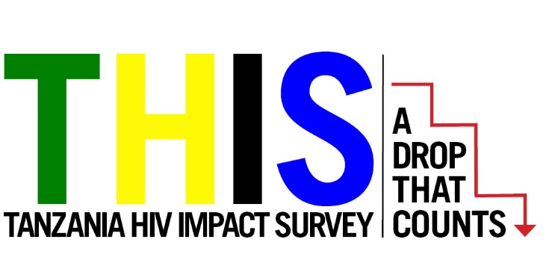
Summary Sheet Figures and Maps
The mark “CDC” is owned by the US Dept. of Health and Human Services and is used with permission. Use of this logo is not an endorsement by HHS or CDC of any particular product, service, or enterprise.
This project is supported by the U.S. President’s Emergency Plan for AIDS Relief (PEPFAR) through CDC under the terms of cooperative agreement #U2GGH001226. The findings and conclusions in this report are those of the authors and do not necessarily represent the official position of the funding agencies
Updated December 2018
Notes:
Ministry of Health, Community Development, Gender, Elderly and Children (MoHCDGEC) and the Ministry of Health Zanzibar, Tanzania, Centers for Disease Control and Prevention (CDC), and ICAP at Columbia University. Tanzania HIV Impact Survey (THIS) 2015-16: Summary Sheet. Dodoma, Tanzania, Atlanta, Georgia and New York, New York, USA: Ministry of Health, CDC and ICAP. December 2017.

Slide 2
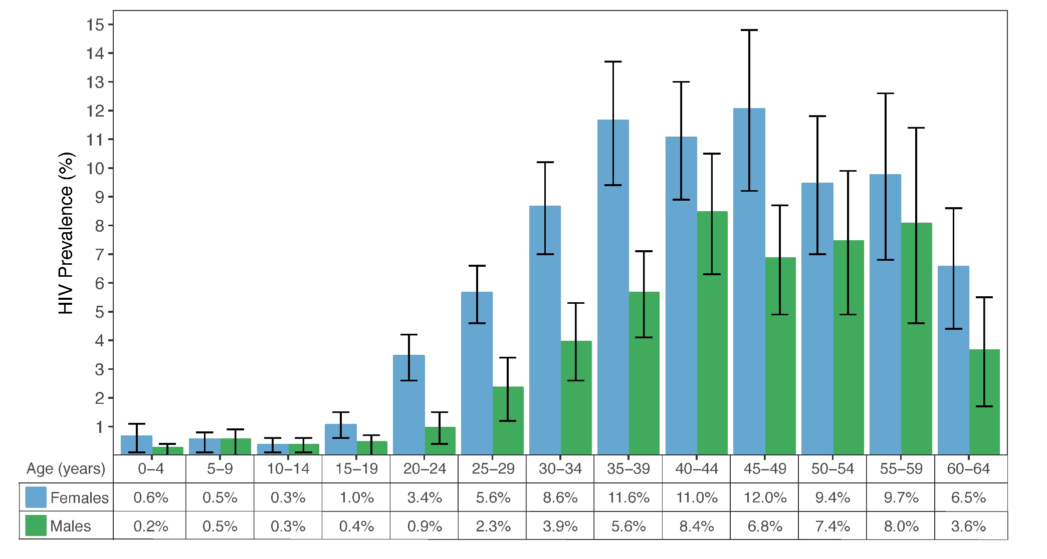
HIV Prevalence by Age and Sex, THIS 2016-2017
Error bars represent 95% confidence intervals.
Notes:
HIV prevalence peaks at 12 percent among females aged 45 to 49, as compared to a peak of 8.4 percent among males aged 40 to 44. HIV prevalence among 15 to 24 year olds is 1.4 percent (2.1 percent among females and 0.6 percent among males). The disparity in HIV prevalence between males and females is most pronounced among younger adults, with prevalence among women in age groups 15 to 19, 20 to 24, 25 to 29, 30 to 34, and 35 to 39 more than double that of males in the same age groups.

Slide 3
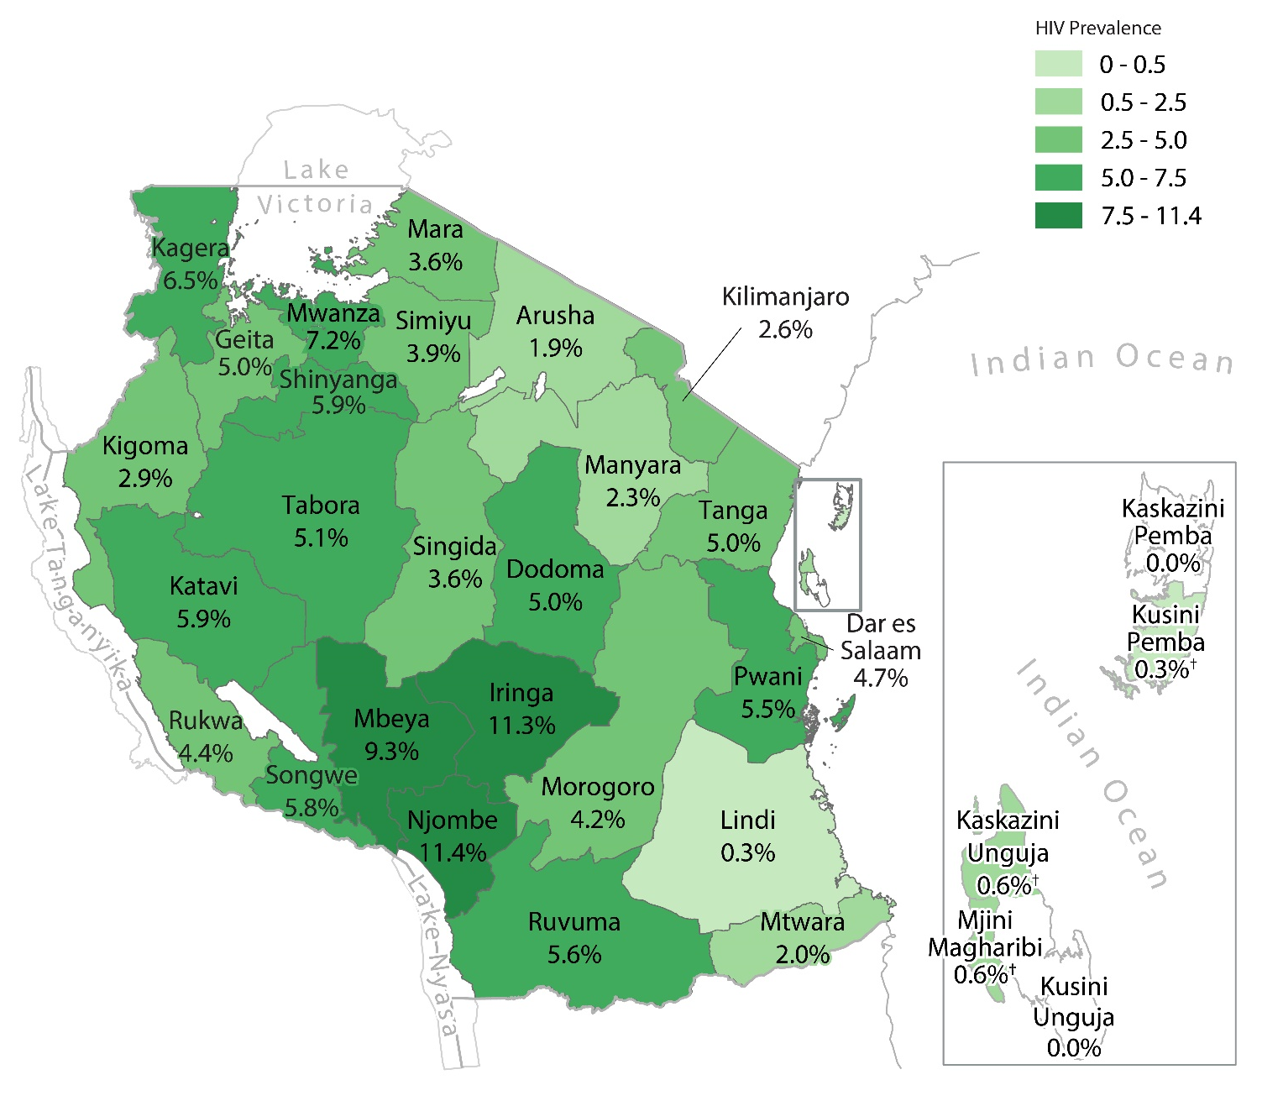
HIV Prevalence Among Adults 15+, by Region, THIS 2016-2017
* Indicates zero cases
Notes:
Among adults 15 years and older, HIV prevalence varies geographically across Tanzania, ranging from 11.4 percent in Njombe to less than one percent (<1%) in Lindi and Zanzibar.

Slide 4
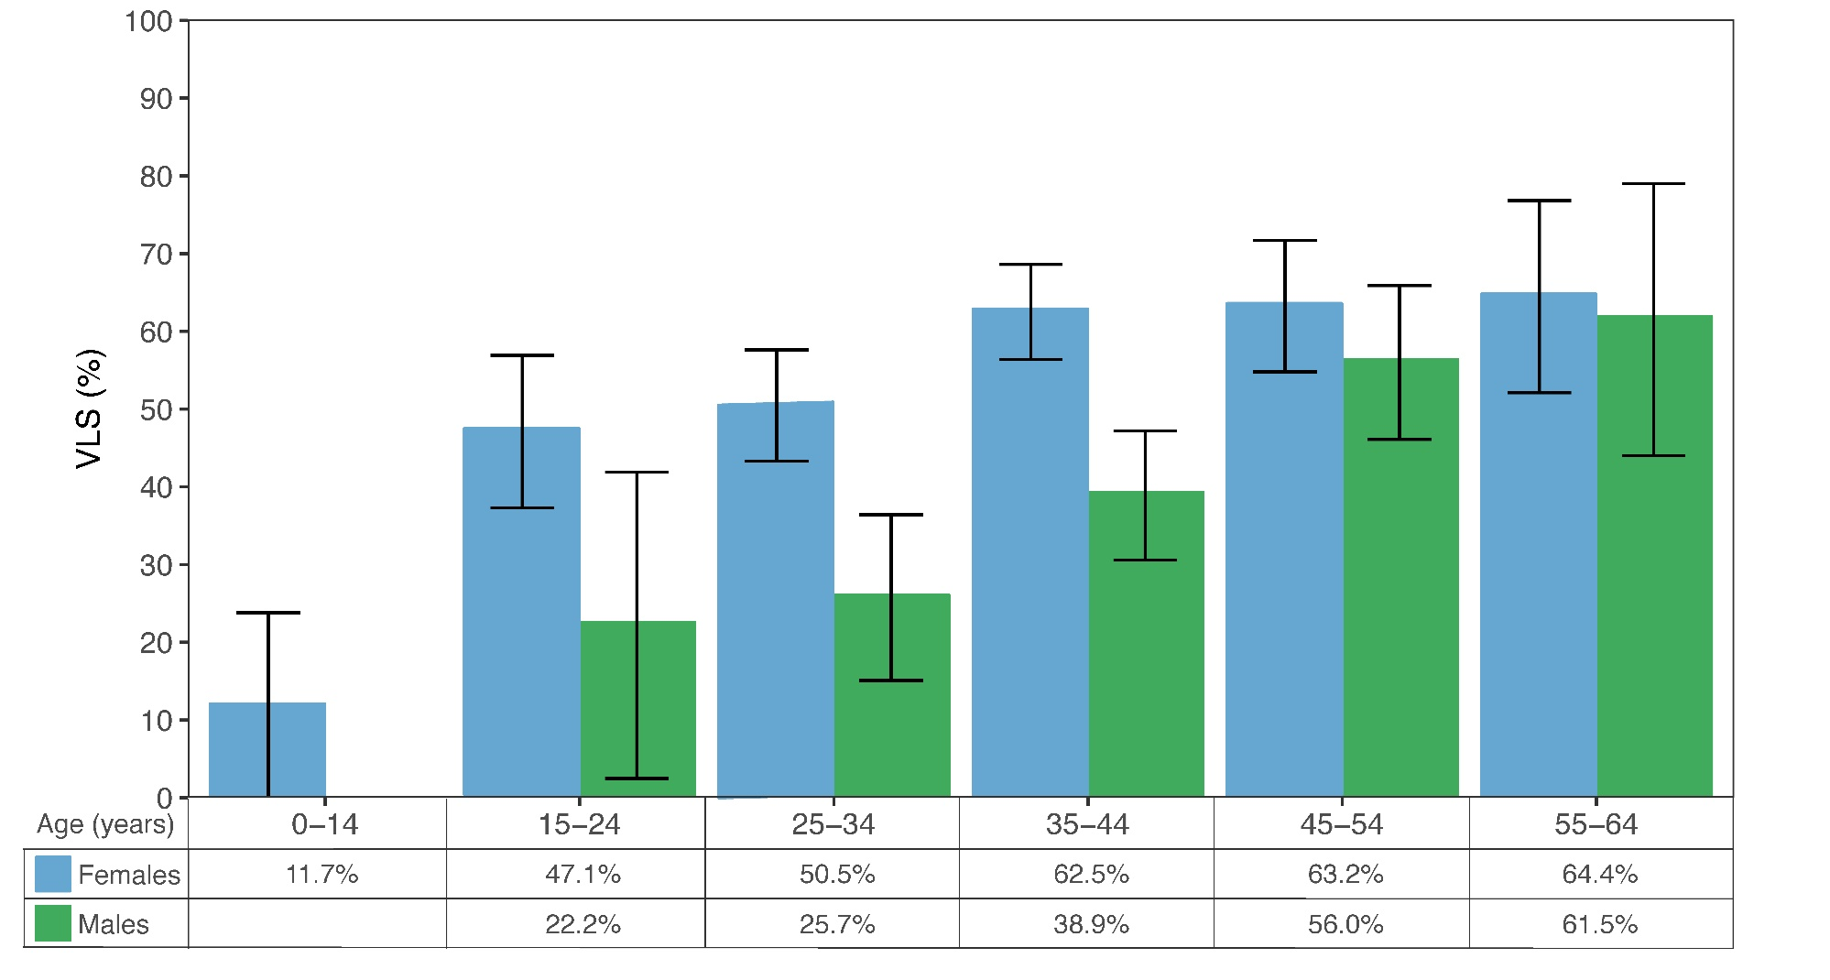
Viral Load Suppression Among People Living with HIV, by Age and Sex, THIS 2016-2017
Error bars represent 95% confidence intervals.
Notes:
Viral load suppression among HIV positive individuals in Tanzania is highest among older adults, with 64.4 percent of females ages 55 to 64 virally suppressed, and 61.5 percent of males ages 55 to 64 virally suppressed. Gender disparity in viral load suppression is greater among younger adults, with 50.5 percent of females ages 25 to 34 virally suppressed and 25.7 percent of men in the same age group virally suppressed.

Slide 5
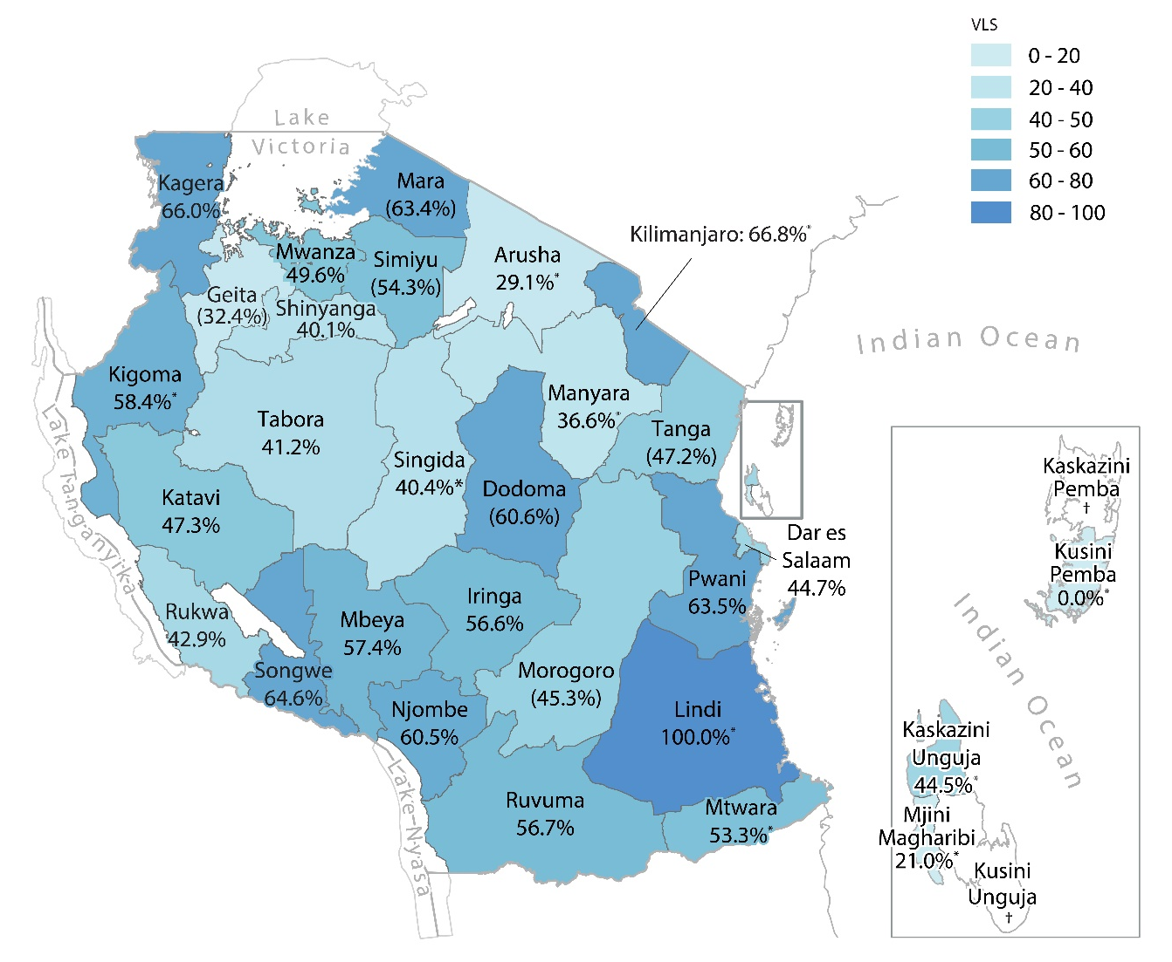
Viral Load Suppression Among People Living with HIV, Aged 15+, by Region, THIS 2016-2017
* Indicates that estimate is based on <25 observations and should be interpreted with caution; estimates in parentheses are based on 25-49 observations and should also be interpreted with caution; a cross (†) indicates that the region had no HIV positive samples with which to estimate viral load suppression.
Notes:
Among HIV positive adults 15 years and older, VLS varies geographically across Tanzania, ranging from 66.0 percent in Kagera and 66.8‡ percent in Kilimanjaro to 40.1 percent in Shinyanga and 29.1‡ percent in Arusha.

Slide 6
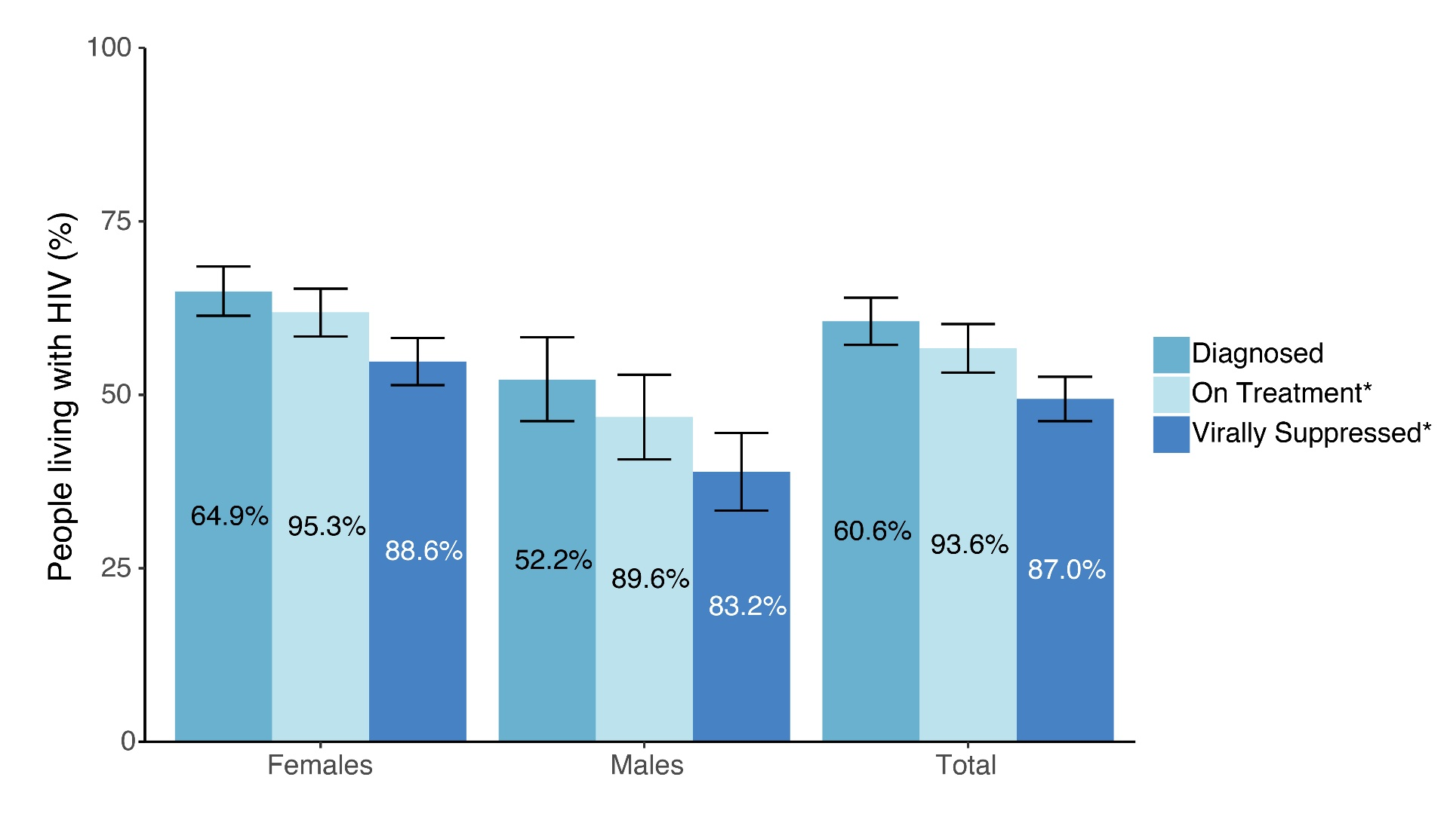
Achievement of the 90-90-90 Goals Among HIV-Positive Adults, by Sex,
THIS 2016-2017
Error bars represent 95% confidence intervals.
*Inset numbers are conditional proportions.
Diagnosed: awareness was defined as self-reporting HIV positive and/ or having a detectable antiretroviral (ARV) in the blood.
On Treatment: being on ART was defined as self-reporting current use of ART and/or having a detectable ARV in the blood.
Notes:
90–90–90: an ambitious treatment target to help end the AIDS epidemic By 2020, 90 percent of all PLHIV will know their HIV status; 90 percent of all people with diagnosed HIV infection will receive sustained antiretroviral therapy (ART); and 90 percent of all people receiving ART will have viral suppression.
Diagnosed In Tanzania, 60.6 percent of PLHIV ages 15 years and older are aware of their HIV status: 64.9 percent of HIV-positive females and 52.2 percent of HIV- positive males. Awareness was defined as self-reporting HIV positive and/or having a detectable antiretroviral (ARV) in the blood following laboratory testing.
On Treatment Among PLHIV ages 15 years and older who know their HIV status, 93.6 percent are on ART: 95.3 percent of HIV-positive females and 89.6 percent of HIV-positive males. Being on ART was defined as self-reporting current use of ART and/or having a detectable ARV in the blood following laboratory testing.
Virally Suppressed Among PLHIV ages 15 years and older years who self report current use of ART and/or had a detectable ARV in their blood following laboratory testing, 87.0 percent (88.6 percent of HIV-positive females and 83.2 percent of HIV-positive males) are virally suppressed.

Slide 7
Find the THIS Summary Sheet
and additional PHIA Project results at:
phia.icap.columbia.edu
The mark “CDC” is owned by the US Dept. of Health and Human Services and is used with permission. Use of this logo is not an endorsement by HHS or CDC of any particular product, service, or enterprise.
This project is supported by the U.S. President’s Emergency Plan for AIDS Relief (PEPFAR) through CDC under the terms of cooperative agreement #U2GGH001226. The findings and conclusions in this report are those of the authors and do not necessarily represent the official position of the funding agencies

