Slide 1
Summary Sheet Figures and Maps
The mark “CDC” is owned by the US Dept. of Health and Human Services and is used with permission. Use of this logo is not an endorsement by HHS or CDC of any particular product, service, or enterprise.
This project is supported by the U.S. President’s Emergency Plan for AIDS Relief (PEPFAR) through CDC under the terms of cooperative agreement #U2GGH001226. The findings and conclusions in this report are those of the authors and do not necessarily represent the official position of the funding agencies
Released July 2018
Notes:
Ministry of Health, Namibia, Centers for Disease Control and Prevention (CDC), University of California, San Francisco, and ICAP at Columbia University. Namibia Population-based HIV Impact Assessment (NAMPHIA) 2015-16: Summary Sheet. Lilongwe, Malawi, Atlanta, Georgia and New York, New York, USA: Ministry of Health, CDC and ICAP. July 2018.

Slide 2
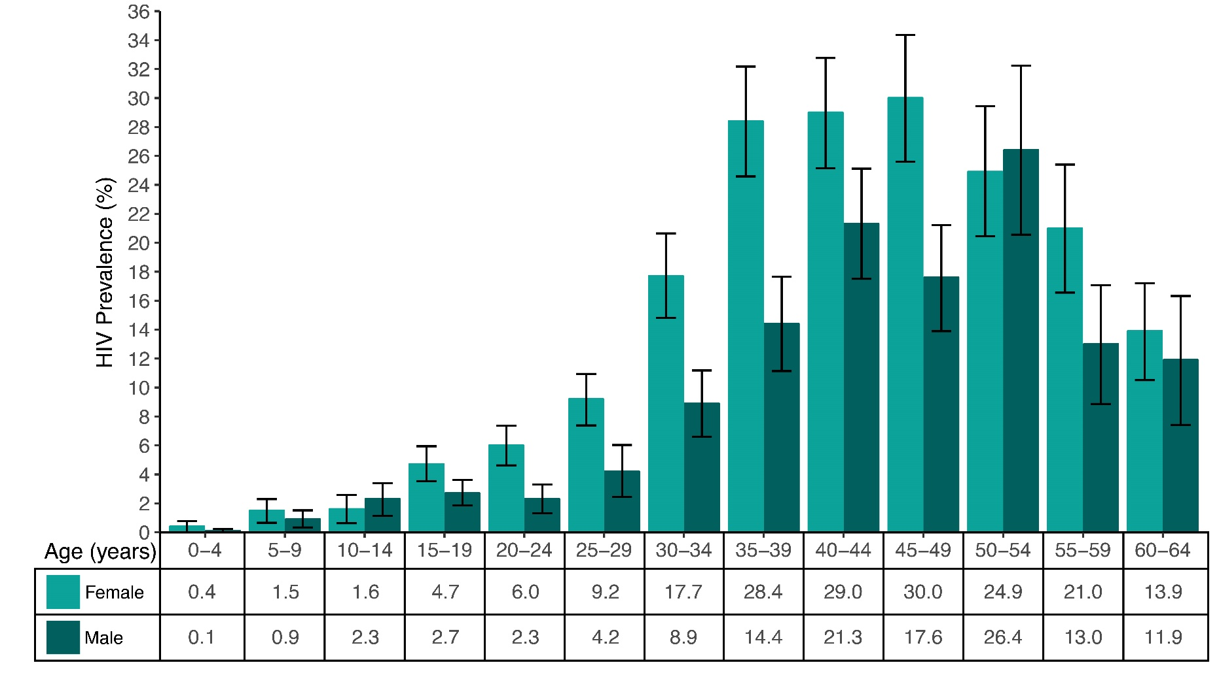
HIV Prevalence by Age and Sex, NAMPHIA 2017
Error bars represent 95% confidence intervals.
Notes:
HIV prevalence peaked at 30.0% among females aged 45-49 years as compared to 26.4% among males aged 50-54 years. HIV prevalence was higher in women than men throughout the reproductive years (15-49). The disparity was most pronounced among those aged 35-39 years, with HIV-positive females at 28.4% and males at 14.4%, and among those aged 20-24 years, with HIV-positive females at 6.0% and males at 2.3%

Slide 3
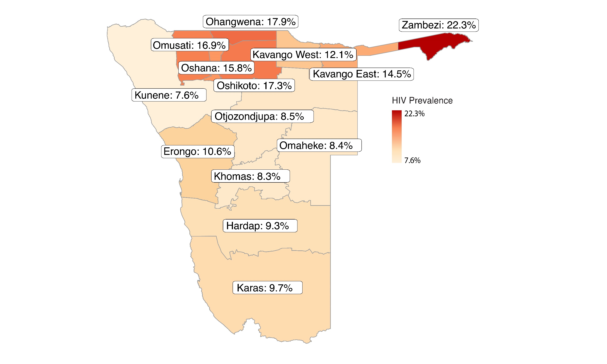
HIV Prevalence Among Adults,
by Region, NAMPHIA 2017
Notes:
Among adults aged 15-64 years, prevalence of HIV varies geographically across Namibia, ranging from 7.6% in Kunene to 17.9% and 22.3% in Ohangwena and Zambezi, respectively. Regions with higher than national prevalence tended to have higher HIV prevalence among females than males. The regions with the lowest prevalence were Kunene and Khomas.

Slide 4
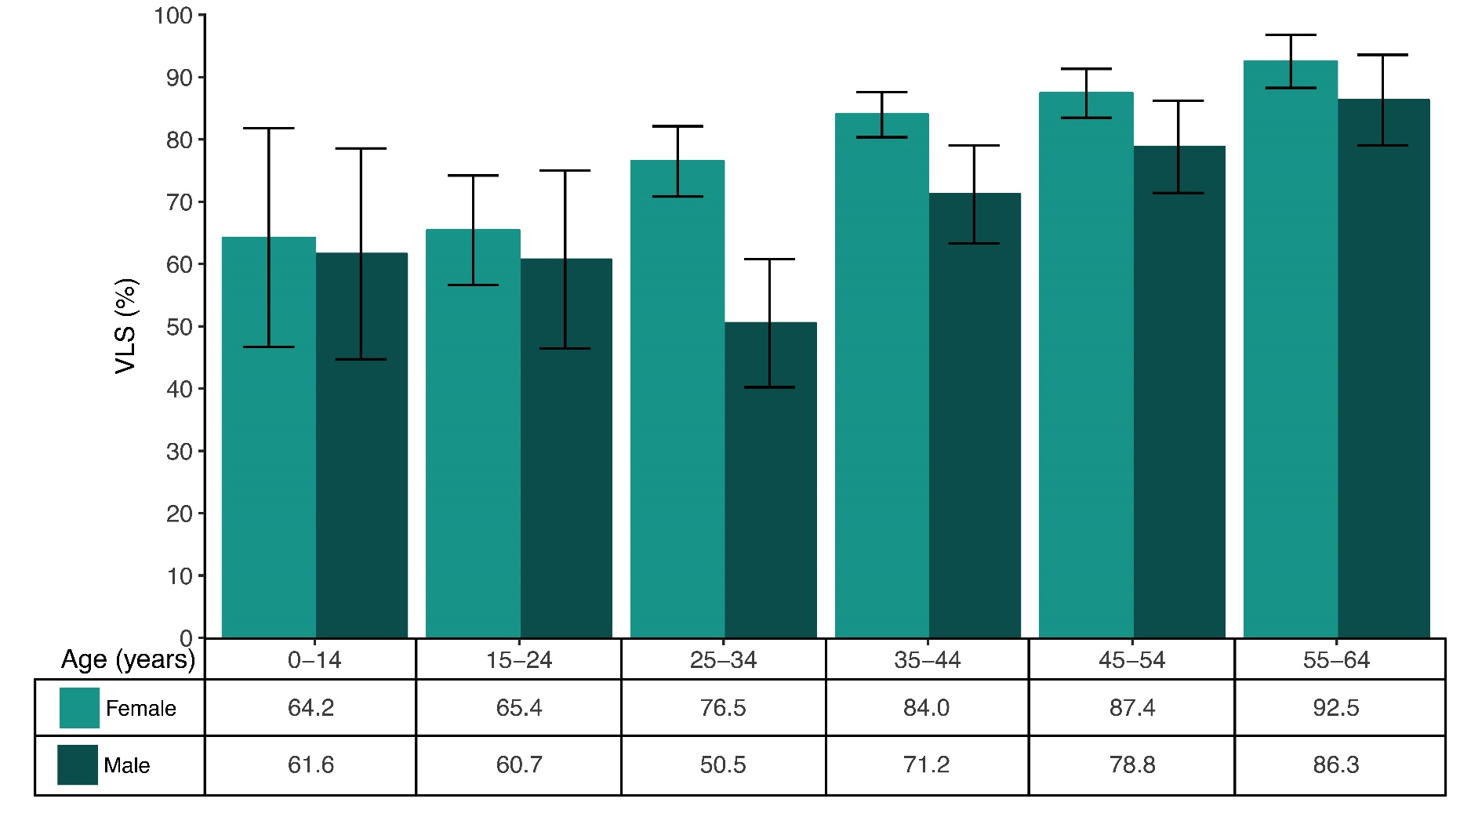
Viral Load Suppression Among HIV-Positive People, by Age and Sex,
NAMPHIA 2017
*Estimates are based on 25-49 unweighted cases and should be interpreted with caution.
Error bars represent 95% confidence intervals.
Notes:
Prevalence of VLS (HIV RNA <1,000 copies/ml among HIV-positive people) was highest among older adults: 92.5% among HIV-positive females and 86.3% among HIV-positive males aged 55-64 years. In contrast, prevalence of VLS was lowest among younger adults: 65.4% among HIV-positive females aged 15-24 years, and 50.5% among HIV-positive males aged 25-34 years. The difference in VLS among females and males was most pronounced among those aged 25-34 years, with HIV-positive females at 76.5% and males at 50.5%.

Slide 5
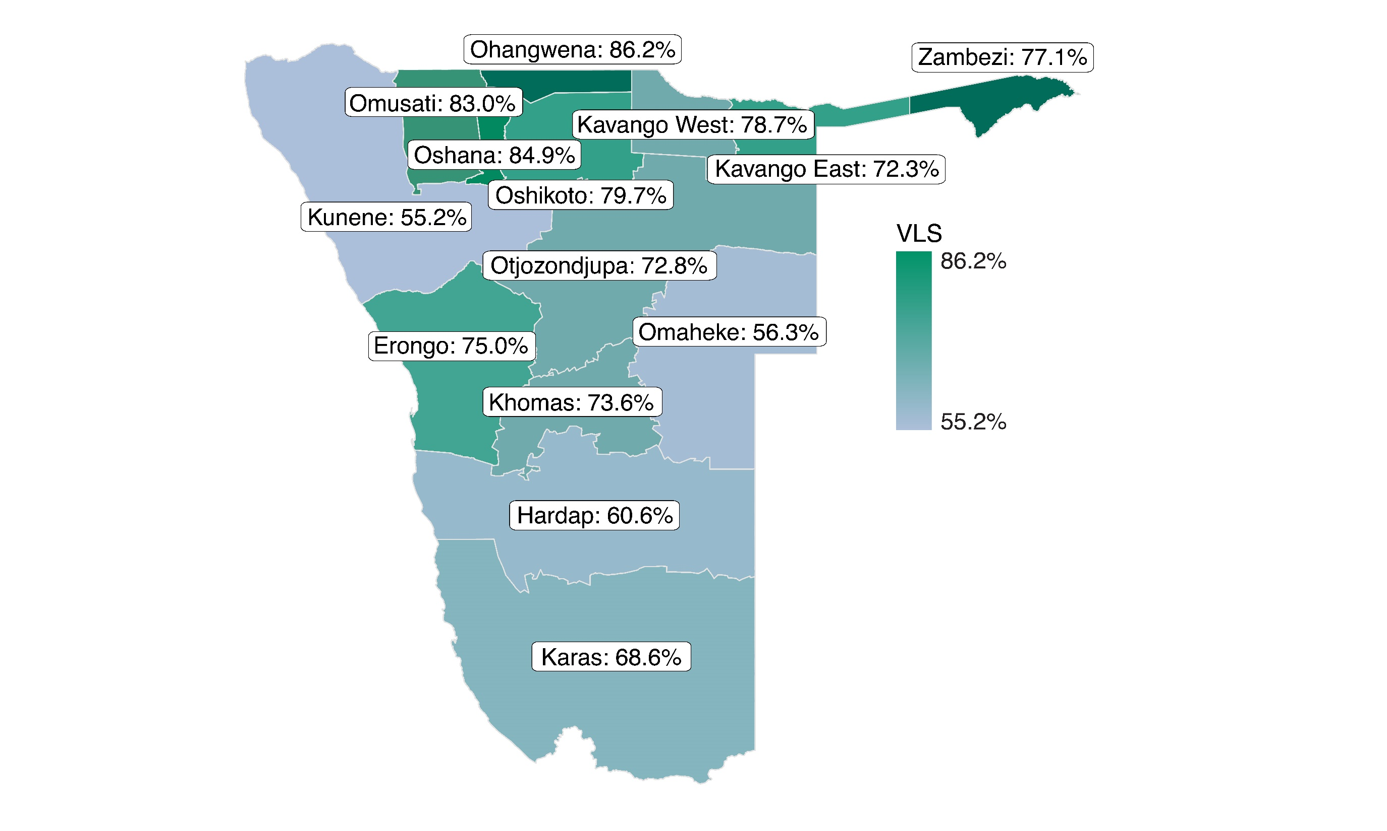
Viral Load Suppression Among
HIV-Positive Adults, by Region,
NAMPHIA 2017
Notes:
Among HIV-positive adults aged 15-64 years, prevalence of VLS varied geographically across Namibia, ranging from 55.2% in Kunene to 86.2% in Ohangwena.

Slide 6
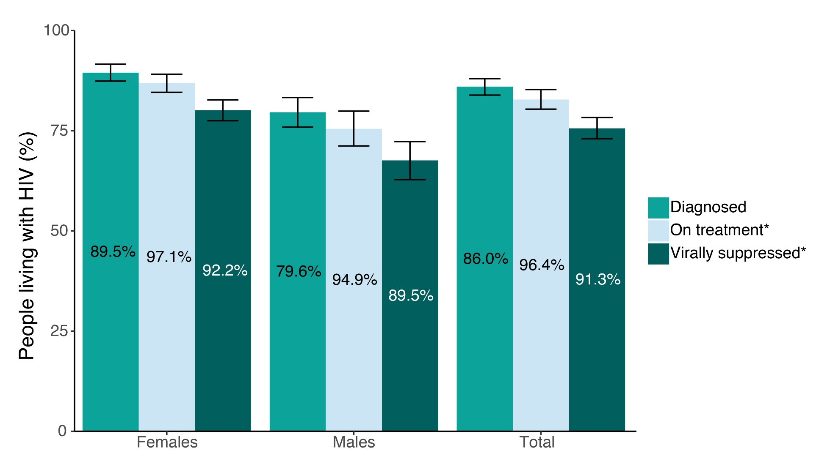
Achievement of the 90-90-90 Goals Among HIV-Positive Adults, by Sex,
NAMPHIA 2017
Diagnosed: awareness was defined as self-reporting HIV positive and/ or having a detectable antiretroviral (ARV) in the blood.
On Treatment: being on ART was defined as self-reporting current use of ART and/or having a detectable ARV in the blood.
*Inset numbers are conditional proportions.
Error bars represent 95% confidence intervals.
Notes:
90–90–90: An ambitious treatment target to help end the AIDS epidemic
UNAIDS and affected countries have set the 90-90-90 targets by 2020: 90% of all PLHIV will know their HIV status; 90% of all people with diagnosed HIV infection will receive sustained antiretroviral therapy (ART); and 90% of all people receiving ART will have viral suppression.
Diagnosed
In Namibia, 86.0% of PLHIV aged 15-64 years reported knowing (being aware of) their HIV status: 89.5% of HIV-positive females and 79.6% of HIV-positive males. Awareness was defined as self-reported HIV positive and/ or having a detectable antiretroviral (ARV) in the blood.
On Treatment
Among PLHIV aged 15-64 years who knew their HIV status, 96.4% self-reported current use of ART: 97.1% of HIV-positive females and 94.9% of HIV-positive males who knew their HIV status self-reported current use of ART. Being on ART was defined as self-reporting current use of ART and/or having a detectable ARV in the blood.
Virally Suppressed
Among PLHIV aged 15-64 years who self-reported current use of ART and/or had a detectable ARV in their blood, 91.3% were virally suppressed: 92.2% of HIV-positive females and 89.5% of HIV-positive males were virally suppressed.

Slide 7
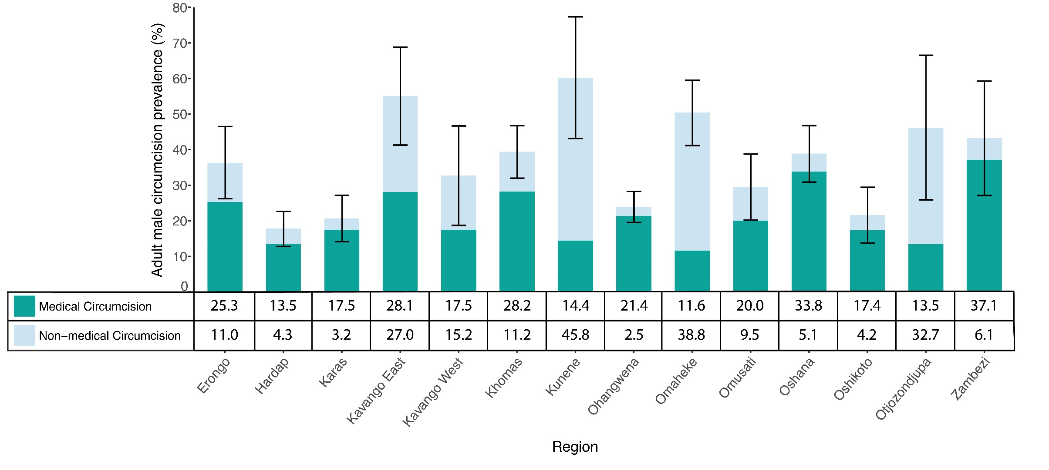
Medical and Non-Medical Circumcision Among Adult Males, by Region,
NAMPHIA 2017
Self-reported circumcision only includes those who are fully circumcised either through medical or traditional methods.
Error bars represent pooled (medical and non-medical circumcision) 95% confidence intervals.
Notes:
Among males aged 15-64 years, prevalence of self-reported complete (non-medical and medical) male circumcision was 36.4%. Circumcision rates ranged geographically, from a low of 17.8% in Hardap to a high of 60.2% in Kunene region. Regions with the highest non-medical circumcision rates were Kavango East, Kunene, Omaheke, and Otjozondjupa. Medical circumcision rates in Zambezi, Oshana, and Ohangwena were more than six times higher than non-medical circumcision rates.

Slide 8
Find the NAMPHIA Summary Sheet
and additional PHIA Project results at:
phia.icap.columbia.edu
The mark “CDC” is owned by the US Dept. of Health and Human Services and is used with permission. Use of this logo is not an endorsement by HHS or CDC of any particular product, service, or enterprise.
This project is supported by the U.S. President’s Emergency Plan for AIDS Relief (PEPFAR) through CDC under the terms of cooperative agreement #U2GGH001226. The findings and conclusions in this report are those of the authors and do not necessarily represent the official position of the funding agencies

